Slide 1

JAWAHARLAL NEHRU TECHNOLOGICAL UNIVERSITY KAKINADA UNIVERSITY COLLEGE OF ENGINEERING VIZIANAGARAM DEPARTMENT OF ELECTRONICS AND COMMUNICATION ENGINEERING(E.C.E)
IMPLEMENTATION OF IMAGE ENHANCEMENT TECHNIQUES
USING HARDWARE AND SOFTWARE
PROJECT MEMBERS:
P.Bala Sai Manasa : 16VV1A0440
SK.Shakeera : 17VV5A0465
K.Varshini : 16VV1A0419
P.Dorababu : 16VV1A0444
Y.Hemanth : 16VV1A0456
PROJECT GUIDE
Prof.CH.Srinivasa Rao
Department of ECE.

Slide 2
Insight:
Introduction to image enhancement.
Image enhancement techniques
Contrast stretching.
Negative image transform.
Power law transform.
Histogram Equalization.
Log transform.
Median Filtering.
Results obtained by matlab.
Comparison table.
Image Enhancement using Xilinx.
Image Enhancement using python.
Conclusion and future scope
References

Slide 3
Image Enhancement
Image enhancement is the processing of images to improve their appearance to human viewers or to enhance other image processing systems performance.
Methods and objectives vary with the application, the objective may be to improve perceptual aspects: image quality, intelligibility, or visual appearance.
In other applications, such as object identification by machine, an image may be pre-processed to aid machine performance.
Because the objective of image enhancement is dependent on the application context, and the criteria for enhancement are often subjective or too complex to be easily converted to useful objective measures, image enhancement algorithms tend to be simple, qualitative, and disambiguation

Slide 4
Image Enhancement Techniques
Image enhancement techniques are of different types some of them are
Contrast Stretching
Power law transform
Image negative
Log Transform.
Histogram Equalization.

Slide 5
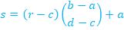
Contrast Stretching
Contrast stretching attempts to improve an image by stretching the range of intensity values it contains to make full use of possible values.
There exists a one- to-one relationship of the intensity values between source image and target image i.e the original image can be restored from contrast stretched image.
CONTRAST STRETCHINGALGORITHM:
Read the image pixel by pixel.
Determine the limits over which image intensity values will be extended. These lower and upper limits will be called a and b, respectively (for standard 8-bit Gray scale pictures, these limits are usually 0 and 255).
Compute the value limits (min. = c, max. = d) in the unmodified picture .Then for each pixel, the original value r is mapped to output value s using the function below

Slide 6
Power law transform
This transformation function is also called as gamma correction, which is given by the expression
s = c .r^γ
For various values of γ different levels of enhancements can be obtained.
This technique is quite commonly called as Gamma Correction. If you notice, different display monitors display images at different intensities and clarity.
That means, every monitor has built-in gamma correction in it with certain gamma ranges and so a good monitor automatically corrects all the images displayed on it for the best contrast to give user the best experience.

Slide 7
Negative Image Transformation
Image negative is produced by subtracting each pixel from the maximum intensity value. e.g. for an 8-bit image, the max intensity value is 2⁸– 1 = 255, thus each pixel is subtracted from 255 to produce the output image.
Thus, the transformation function used in image negative is
S =T(r) =L-1-r.
Where L-1 is the max intensity value and s, and r are the output and input pixel values respectively.

Slide 8
Log Transform
In this transform the dark pixels in an image are transformed or expanded as compared to the higher pixel values.
In Log Transform higher pixel values are compressed.
The log transform can be defined by the formula
s = c log(r+1)
here, s and r are the output and input pixel values and c is a constant
The value of c in this adjust the kind of enhancement.

Slide 9
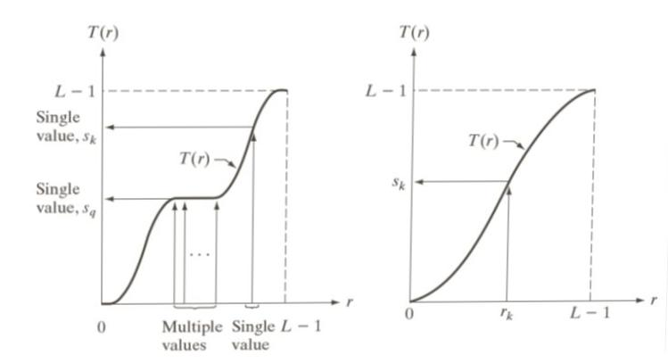
Histogram Equalization
Histogram equalization is a common technique for enhancing the appearance of images. Suppose we have an image which is predominantly dark.
Then its histogram would be skewed towards the lower end of the grey scale and all the image detail is compressed into the dark end of the histogram.
If we could ‘stretch out’ the grey levels at the dark end to produce a more uniformly distributed histogram then the image would become much clearer. Histogram equalization stretches the histogram across the entire spectrum of pixels (0 – 255) .
It increases the contrast of images for the finality of human inspection and can be applied to normalize illumination variations in image understanding problems

Slide 10
Histogram Equalization Algorithm
Read the image pixel by pixel.
Counts the occurrence of each pixel value in the image (256 value).
Compute the cumulative number of pixels (unscaled values).
Multiply each unscaled value with the scaling factor [G-1/MxN] to obtain the new scaled value. where G is the maximum grey level , M is the number of image rows, N is the number of image columns.
Assign a nearest available brightness values to the new scaled value.

Slide 11
Median Filtering
Median filtering is a non-linear, low-pass filtering method, which are used mainly to remove salt-and pepper noise from an image.
It cannot perform linear low-pass filters on this type of noisy image, because it can potentially removes all the noise without affecting the "clean" pixels.
MEDIAN FILTERING ALGORITHM:
Read the image from left to right, top to bottom pixel by pixel.
Initiate a 3 x 3 mask (neighborhood windows), starting from the pixel, whose value is going to change after filtering.
Extract all 3 x 3 mask elements and put into the 1-D element array.
Sort the 1-D element array in ascending order.
Extract the middle value of sorted element array Replace the current pixel value in the image with the medium pixel value in the 1-D element array, Move to the next pixel.
Repeat steps 3 to 6 until end of the image.

Slide 12
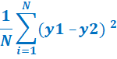
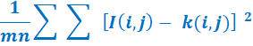
PERFORMANCE MEASURESUSED
The performance measures used are MSE and PSNR.
MSE is nothing but mean square error, it is defined as the average squared difference between the estimated values and the actual value. MSE can be calculated by using formula,
MSE =
PSNR is nothing but peak signal to noise ratio, it is defined as the ratio between the maximum possible power of a signal and the power of corrupting noise that affects the fidelity of its representation. PSNR can be calculated by using the formula.
PSNR =
The units of PSNR is DECIBELS.

Slide 13
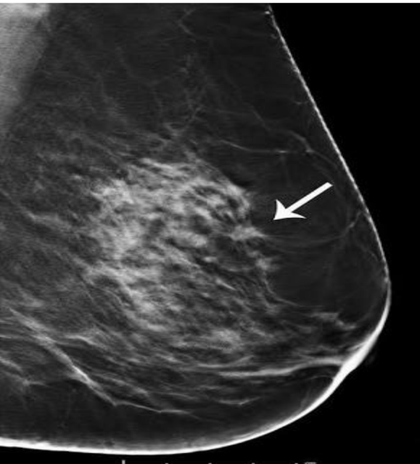
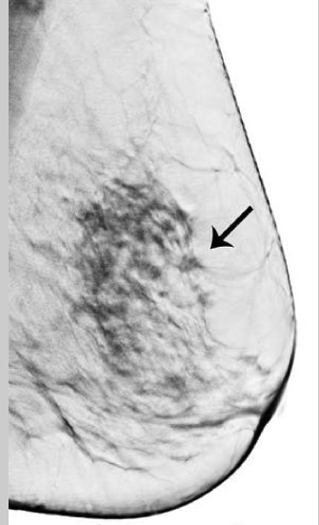
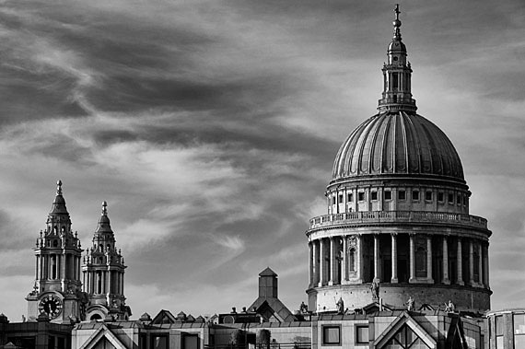
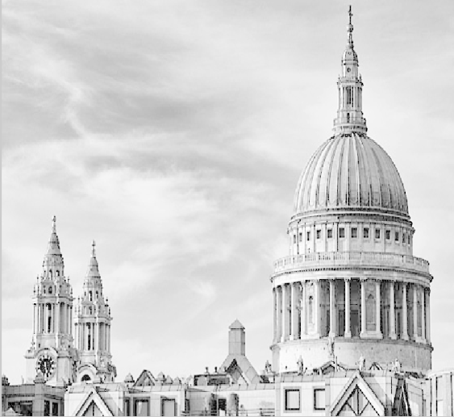
IMAGE EHNACEMENT USING MATLAB RESULTS:
IMAGE NEGATIVE
a. Input image
b. Negative of image
LOG TRANSFORM
a. Input image
b. Image after log transform

Slide 14

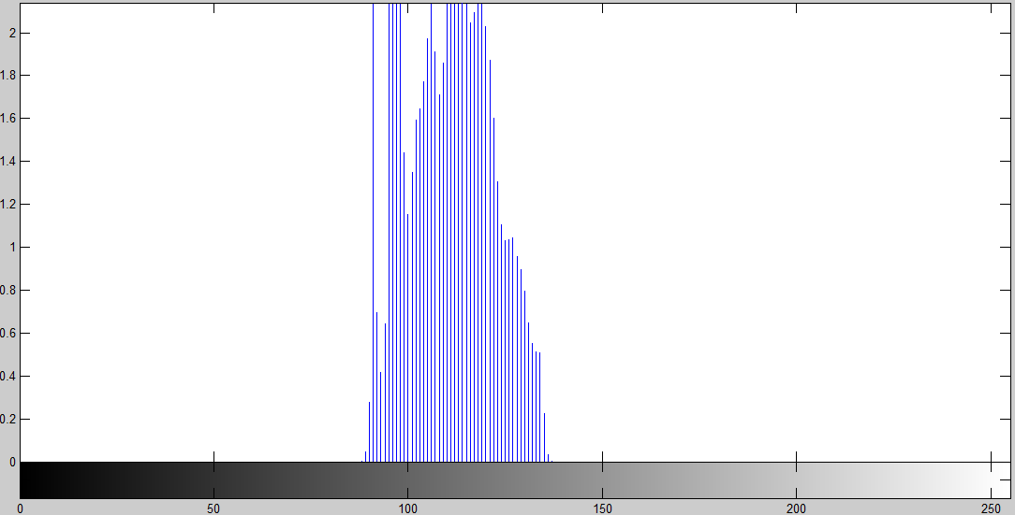
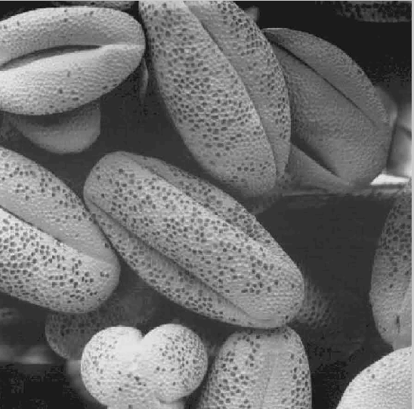
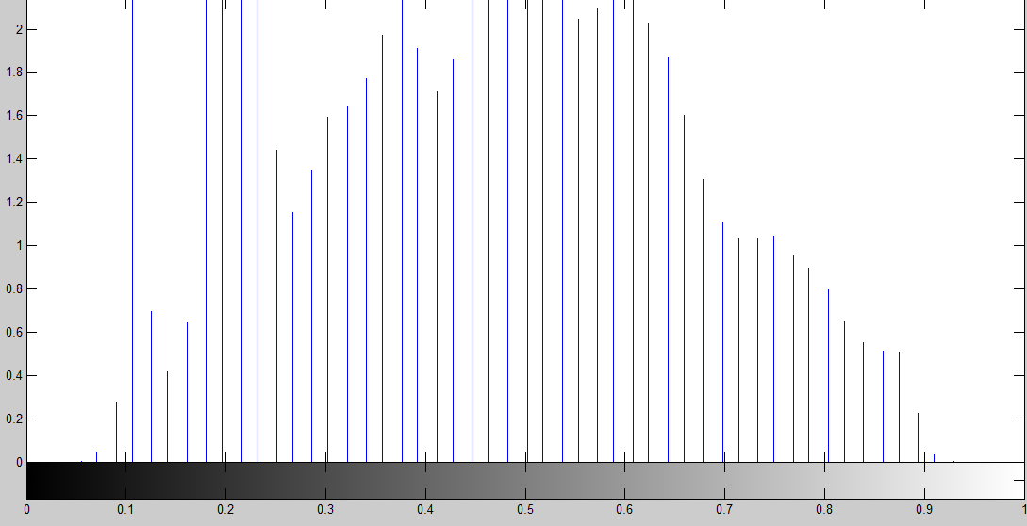
CONTRAST STRETCHING
a. Original image
b. Histogram of original image
a. Contrast stretched image
b. Histogram of contrast stretched image

Slide 15
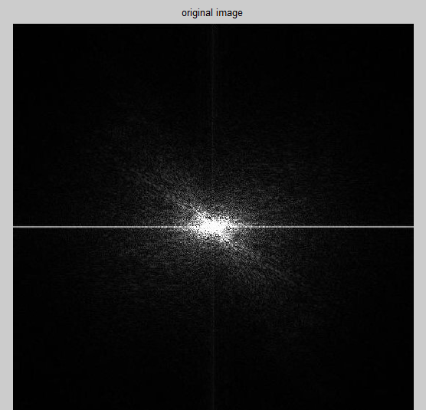
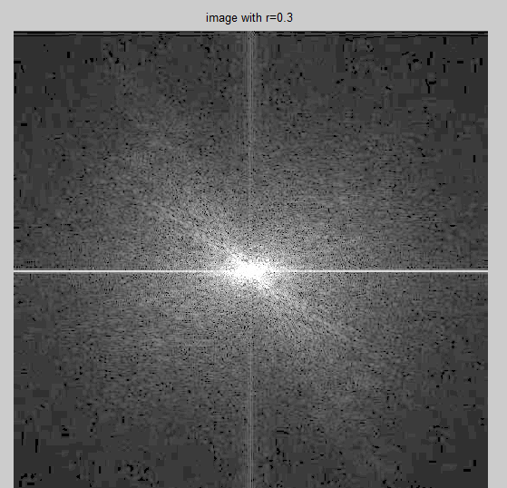
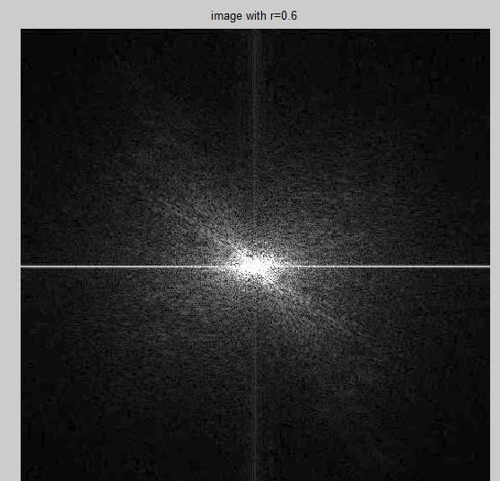
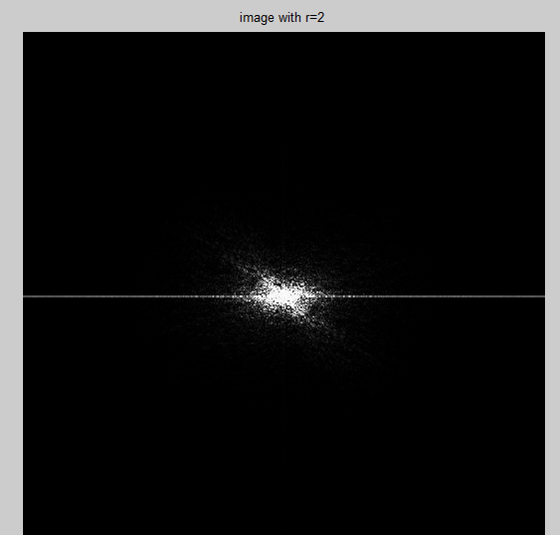
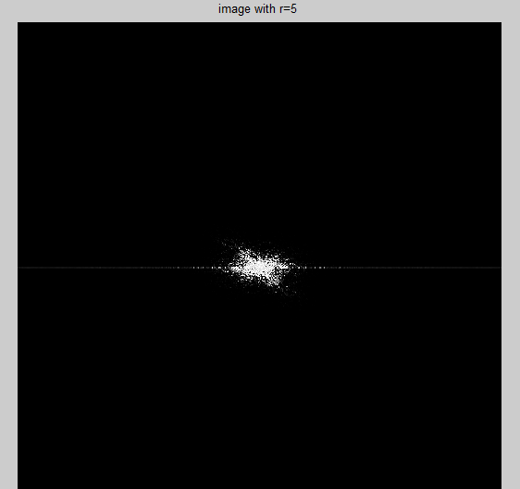
POWER LAW TRANSFORM
a.
b
c.
Original image
Image with gamma=0.3
Image with gamma=0.6
Image with gamma=2
Image with gamma=5
d.
e.

Slide 16
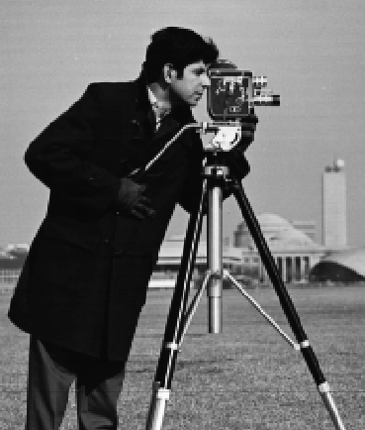
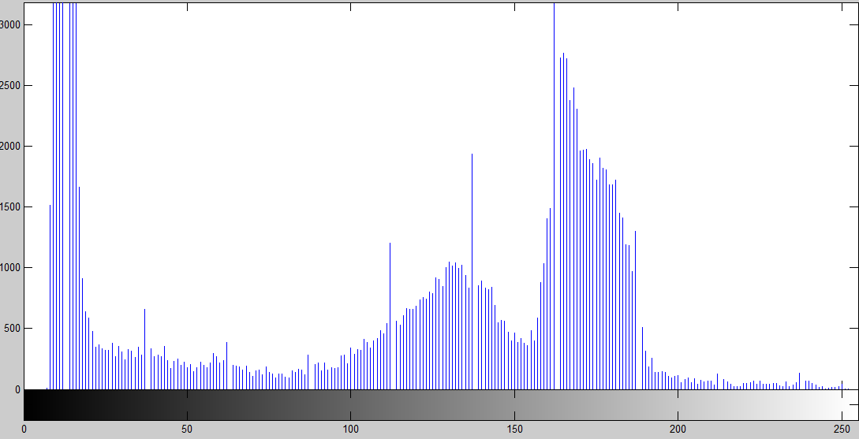
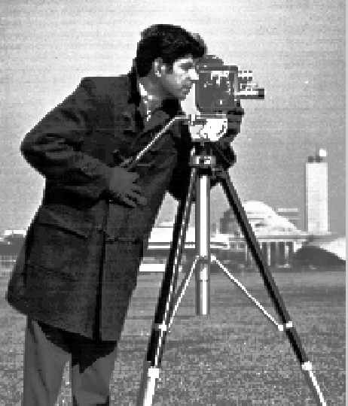
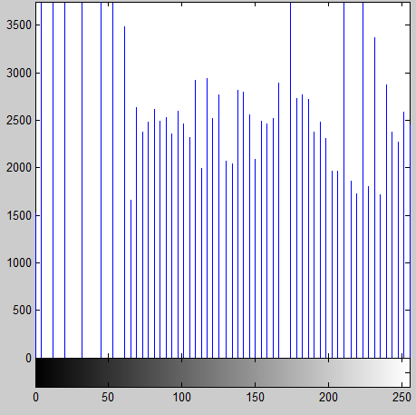
HISTOGRAM EQUALISATION
Original image
Histogram of original image
(a)
(b)
Equalized image
Histogram of equalized image
(a)
(b)

Slide 17
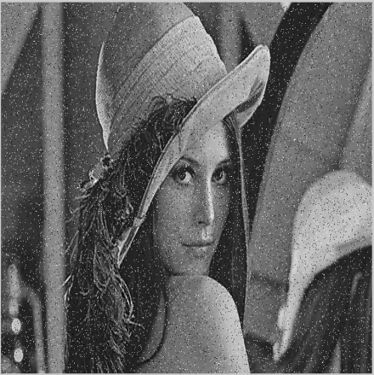
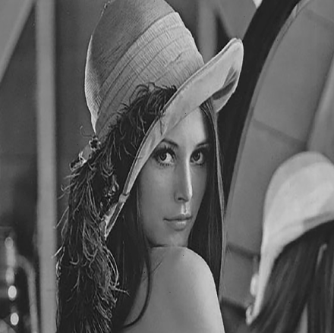
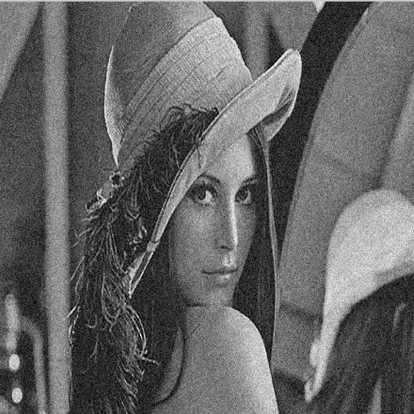
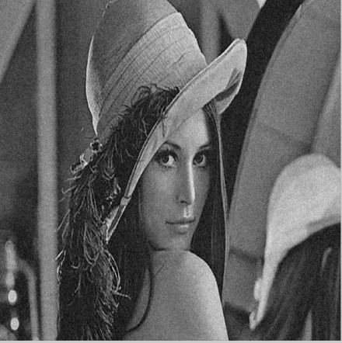
MEDIAN FILTERING
(a). Original image
(b) Image with salt and pepper noise
(c) Image after median filtering
(a)
(b)
(c)
(a). Original image
(b) Image with Gaussian noise
(c) Image after median filtering
(a)
(b)
(c)

Slide 18
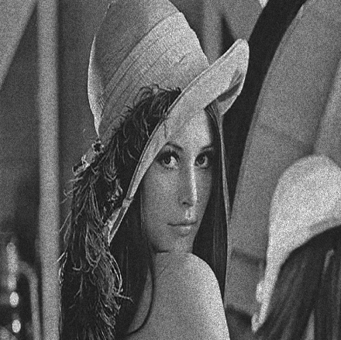
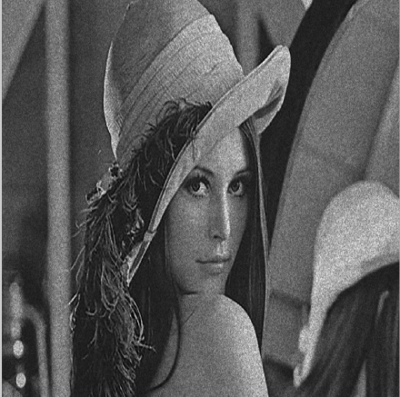
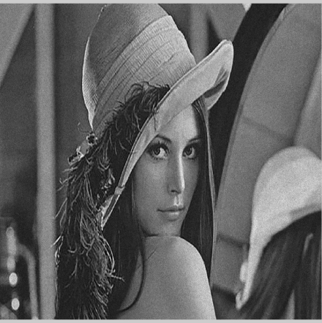
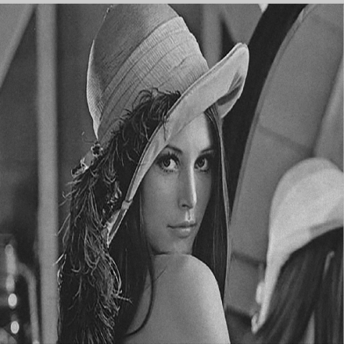
(a) Original image
(b) Image with Speckle noise
(c) Image after median filtering
(a)
(b)
(c)
(a). Original image
(b) Image with Poisson noise
(c) Image after median filtering
(a)
(b)
(c)

Slide 19
COMAPRISION OF MEDIAN FILETERING RESULTS WITH DIFFERENT NOISES
S.no | Noise | PSNR | MSE
1 | Salt and pepper noise | 73.4184 | 0.0029596
2 | Gaussian noise | 68.1852 | 0.0098755
3 | Speckle noise | 69.8153 | 0.006785
4 | Poisson noise | 72.4899 | 0.0014591

Slide 20
MSE and PSNR values of different enhancement techniques
S.no | Image enhancement technique | PSNR value | MSE value
1. | Image negative | 53.9806 | 0.26003
2. | Log transform | 56.6335 | 0.14116
3. | Gamma correction | 64.141 | 0.02506
4. | Contrast stretching | 64.0428 | 0.025633
5. | Histogram Equalization | 47.6399 | 0.7538

Slide 21
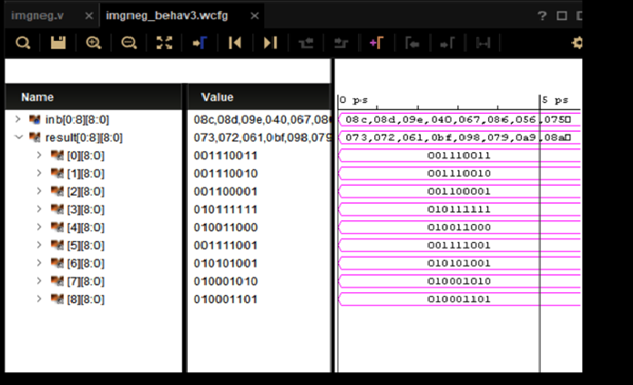
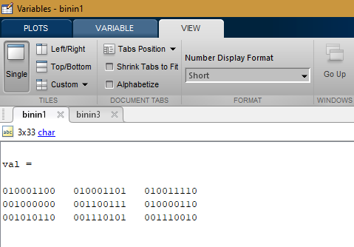
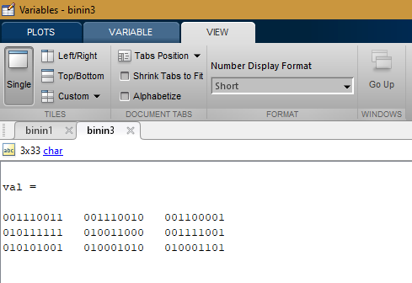
IMAGE ENHMANCE USING XILINX RESULTS
IMAGE NEGATIVE:
Xilinx waveform
Matlab values

Slide 22
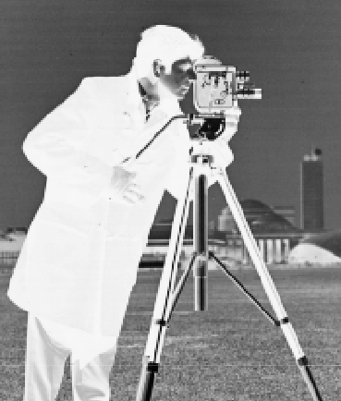
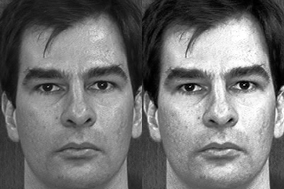
IMAGE ENHANCEMENT USING PYTHON RESULTS
IMAGE NEGATIVE
HISTOGRAM EQUALISATION

Slide 23



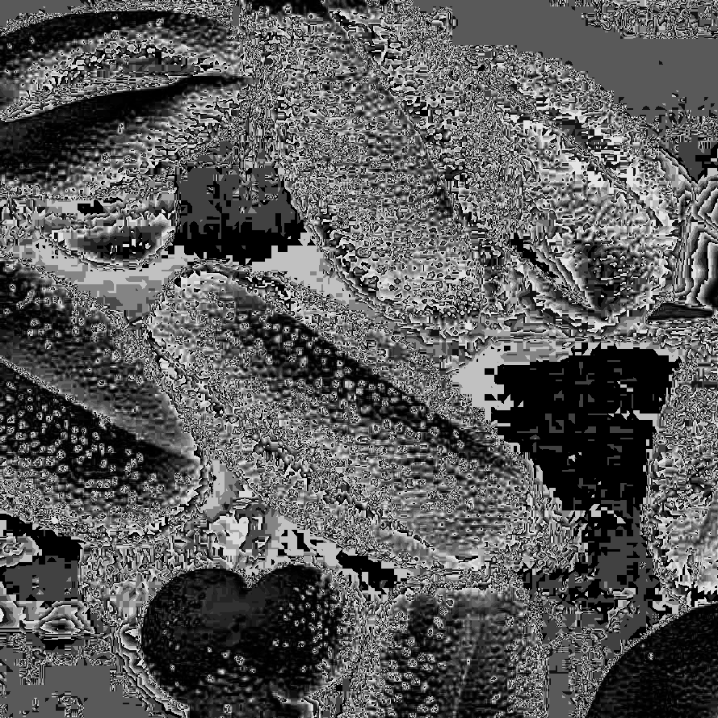
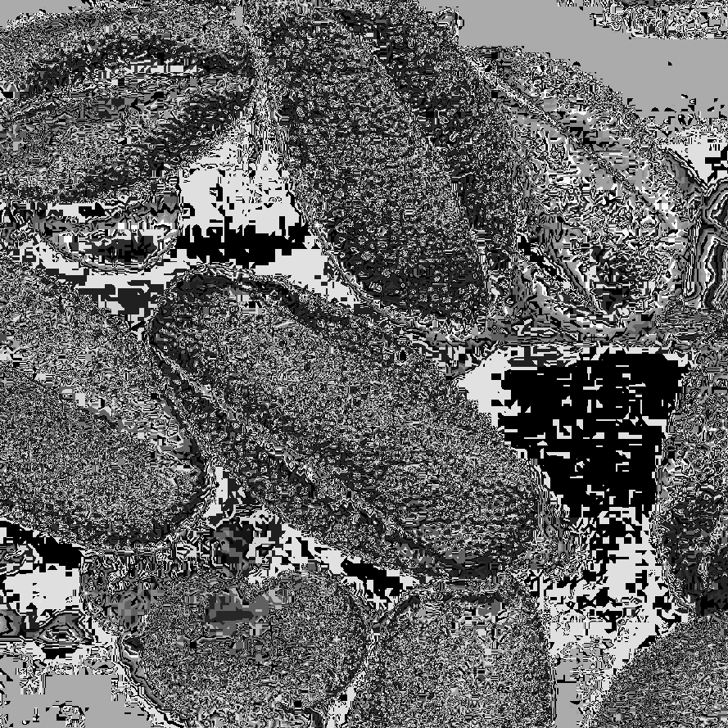
POWER LAW TRANSFORM
(A)
(B)
(C)
Input image
Image with gamma=0.3
Image with gamma=0.6
Image with gamma=2
Image with gamma=5
(D)
(E)

Slide 24
Conclusion AND FUTURE SCOPE
CONCLUSION:
Different image enhancement techniques like, Image negative, log transformation, histogram equalization, contrast stretching, median filtering are explored in this project.
Experiments are conducted for image enhancement using matlab, xilinx and python. Performance measures used are PSNR and MSE.
It has been observed that median filter can be used to enhance images corrupted by salt and pepper noise.
FUTURE SCOPE:
Image enhancement techniques can be implemented in hardware by using hardware boards like raspberry pie or FPGA.
All the image enhancement techniques can be implemented using XILINX.
In future a complete framework can be developed which can check the image and automatically choose the method and enhances the image irrespective of the input type.

Slide 25
REFERENCES
[1] T.M.Bittibssi, G.I.Salama, Y.Z.Mehaseb, Adel E. Henawy, Image enhancement algorithms using FPGA, International Journal of Computer science and communication networks, Vol2(4), 536-542, july 2013.
[2] S.Sowmya, Roy Paily, “FPGA implementation of image enhancement algorithms”, International Conference Communications and Signal Processing (ICCSP), pp.584-588, Feb.2011.
[3] Karan Kumar, Aditya Jain and Atul Kumar Srivastava “FPGA implementation of image enhancement techniques”, Proc. Of SPIE, Vol.750208-7, September 2011.
[4] Lee, Eunsung, et al. "Contrast Enhancement Using Dominant Brightness Level Analysis and Adaptive Intensity Transformation for Remote Sensing Images": pp.62-66 IEEE, 2013.

Slide 26
THANK YOU

